Slide 1
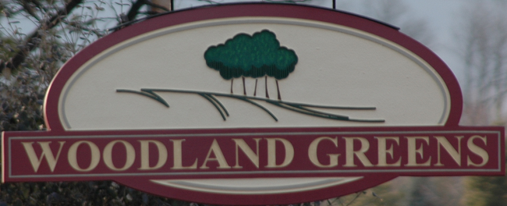

WGHA Annual Meeting
March 4 2025

Slide 2
Agenda
Call to Order
Proof of Notice
Introductions
Financial Report
Neighborhood Update
Voting for Director

Slide 3
Call To Order
Attendance /Establishment of quorum
Proof of notice,
  sent 2/13/25
  Introductions (Name, address, Years of residence)
  Administrator
  Directors

Slide 4
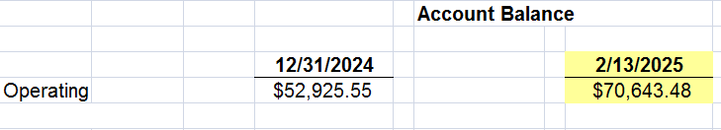
Financial Report – Account Balances
WGHA Operating & Reserves Balance Sheet
As of 12/31/24 (Cash Basis)

Slide 5
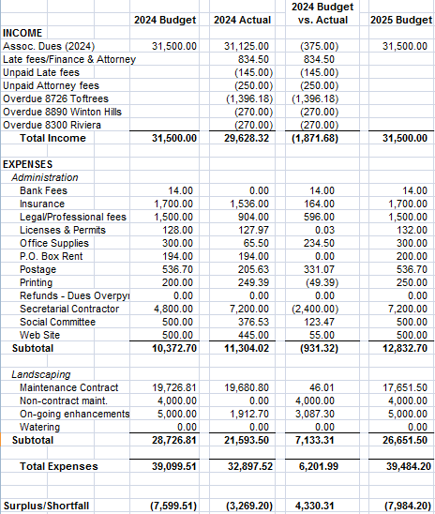
Financial Report - Budget

Slide 6
Annual Dues
As of March 1st 80% of homeowners paid
  50 homes unpaid
  3 homes have liens for multiple years in arrears
$20 on all accounts past due
  Turned over to Attorney for collection
Payment arrangements are handled on a case by case basis
  If unpaid, please contact the HOA to begin resolution process

Slide 7
Neighborhood Update
Woodlandgreens.com
  Meeting minutes posted (annual and monthly)
  All WGHA docs (by-laws, applications, etc)
All Trailers/RV are stored in garage or off-site
  Including but not limited to travel/cargo/mower /boat etc per Convents & Restrictions
Woodland Greens Social Community
  Facebook.com/groups/1498018103633258
  Thanks to Kristen Fecke
  Saturday May 31 2025

Slide 8
Neighborhood Update
Speed limit is 25mph
  Please remind your teenagers to slow down and be mindful of walkers/joggers
Architectural Standards
  Protects home values and neighborhood integrity
  New 2024; Guidelines published to website
  Complete form with as much detail to expedite approval (Sheds, Additions, Fences, Pools)
  Any changes during construction, new application
  Thanks to Judy Burnett, Jason Anderson & Dan King

Slide 9
Neighborhood Update
Fence (Survey highly recommended)
  Township involvement around safety concerns (swimming pools)
  Architectural Standards Committee approval of location, materials and construction
  Fence within 1ft of property line requires written agreement between neighbors highlighting an agreed plan for maintenance, vegetation, financial responsibility in event of storm or useful life removal
    Fences with a 1ft or more setback does not require agreement

Slide 10
Neighborhood Update
2024 Boulevard Update
  Maintenance and plantings
2025- 2026 Boulevard Project
  Healthy and maintenance
  Sign up sheet for plantings/removal of dead items
Lamp Post Bulbs
Neighborly Courtesies
  Please keep trashcans stored out of view
  Please remove yard signs 2 weeks after election
  Please remove Holiday lights by March 1st

Slide 11
Neighborhood Update
Township 748-1267; City 748-4343
after business hours support 425-2525
  Animal control, storm damage, street plow, road/curb maintenance
Dogs
  Please use a leash
  Please clean-up after your dog (including Blvd)
  Contained in your yard
    Respectful of walkers, joggers, children
Propertyfraudalert.com/OHWARREN

Slide 12
Neighborhood Update
Crime increase due to gang activity
  Cars stolen/ransacked
  Keep garage doors closed/ cars locked
  Township daily early morning patrol
Solicitation (Opt out)
  City Homeowners register with the City
  No registration for the township
  Request the solicitor to provide evidence of permit before engaging with solicitor
  Political/ youth activities are exempt from permit

Slide 13
Voting a Director
Call for candidates/nominations
  Annual election per the 2007 adopted By-Laws
  3 year term
Introduction of candidates
Casting of ballots
Tally of Ballots
Election results
Neighborhood Social Hour
  Crooked Handle

Slide 14

Adjourn
Thank you for attending.
Board of Directors:
Nathan Frankart, Michael Mills
Zachary Lawson

