Slide 1
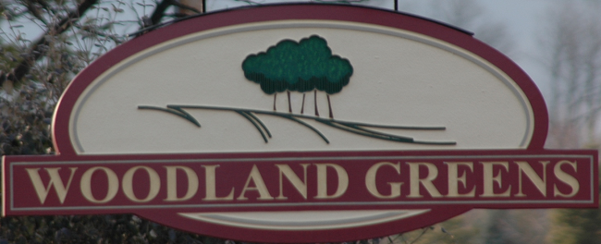

WGHA Annual Meeting
March 21 2023

Slide 2
Agenda
Call to Order
Proof of Notice (2/24/23)
Introductions
Financial Report
Neighborhood Update
Voting for Director

Slide 3
Call To Order
Attendance /Establishment of quorum
Proof of notice,
  sent 2/24/23
  Introductions (Name, address, Years of residence)
  Secretary
  Trustees

Slide 4

Financial Report – Account Balances
WGHA Operating & Reserves Balance Sheet
As of 12/31/22 (Cash Basis)

Slide 5
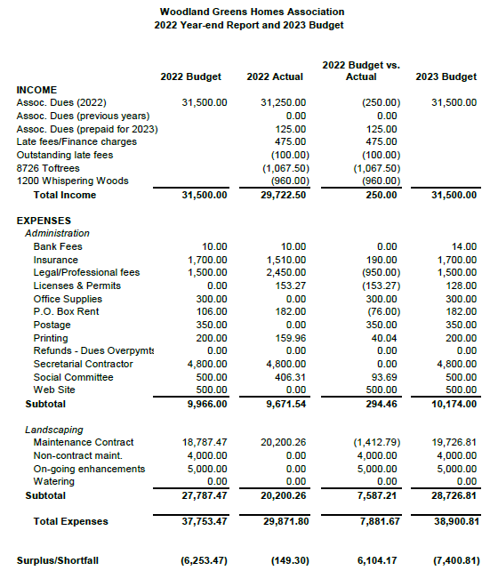
Financial Report - Budget

Slide 6
Annual Dues
As of March 20th , 87% of homeowners paid
  32 homes unpaid
  1 home in probate/foreclosure/Lien
$20 on all accounts past due
  Turned over to Attorney for collection
Payment arrangements are handled on a case by case basis
  If unpaid, please contact the HOA to begin resolution process

Slide 7
Neighborhood Update
Woodlandgreens.com
  Meeting minutes posted (annual and monthly)
  All WGHA docs (by-laws, applications, etc)
Social Committee
  Thanks to Kristen Fecke
Architectural Standards
  Protects the integrity of neighborhood
  Complete form (Sheds, Additions, Fences, Pools)
  Thanks to Judy Burnett & Dan King

Slide 8
Neighborhood Update
Curbing Driveway Project
  Meeting held at Springboro Library
  Residents on list didn’t respond to Pro Tech
  Residents to work individually on their needs
All Trailers/RV are stored in garage or off-site
  Including but not limited to travel/cargo/mower /boat etc per Convents & Restrictions
Speed limit is 25mph
  Please remind your teenagers to slow down and be mindful of walkers/joggers

Slide 9
Neighborhood Update
Fence (Survey highly recommended)
  Township involvement around safety concerns (swimming pools)
  Architectural Standards Committee approval of location, materials and construction
  Fence within 1ft of property line requires written agreement between neighbors highlighting an agreed plan for maintenance, vegetation, financial responsibility in event of storm or useful life removal
    Fences with a 1ft or more setback does not require agreement

Slide 10
Neighborhood Update
2022 Boulevard Update
  Maintenance only
2023- 2024 Boulevard Project
  Healthy and maintenance
Neighborly Courtesies
  Please keep trashcans stored out of view
  Please remove yard signs 2 weeks after election
  Please remove Holiday lights by March 1st
Avenue of Flags- Springboro Optimists Club
  $50 a year

Slide 11
Neighborhood Update
Township 748-1267; City 748-4343
after business hours support 425-2525
  Animal control, storm damage, street plow, road/curb maintenance
Dogs
  Please use a leash
  Please clean-up after your dog
  Contained in your yard
    Respectful of walkers, joggers, children
Lamp Post Bulbs

Slide 12
Voting a Director
Call for candidates/nominations
  Annual election per the 2007 adopted By-Laws
  3 year term
Introduction of candidates
Casting of ballots
Tally of Ballots
Election results
Neighborhood Social Hour
  Crooked Handle

Slide 13

Adjourn
Thank you for attending.
Board of Directors:
President: Michael Mills & Paul VanMaldegham

